Slide 1
CS 252 Database Management Systems
Jan – May 2020
IV Semester
* Use the slides for reference only. Refer the text book for details.

Slide 2
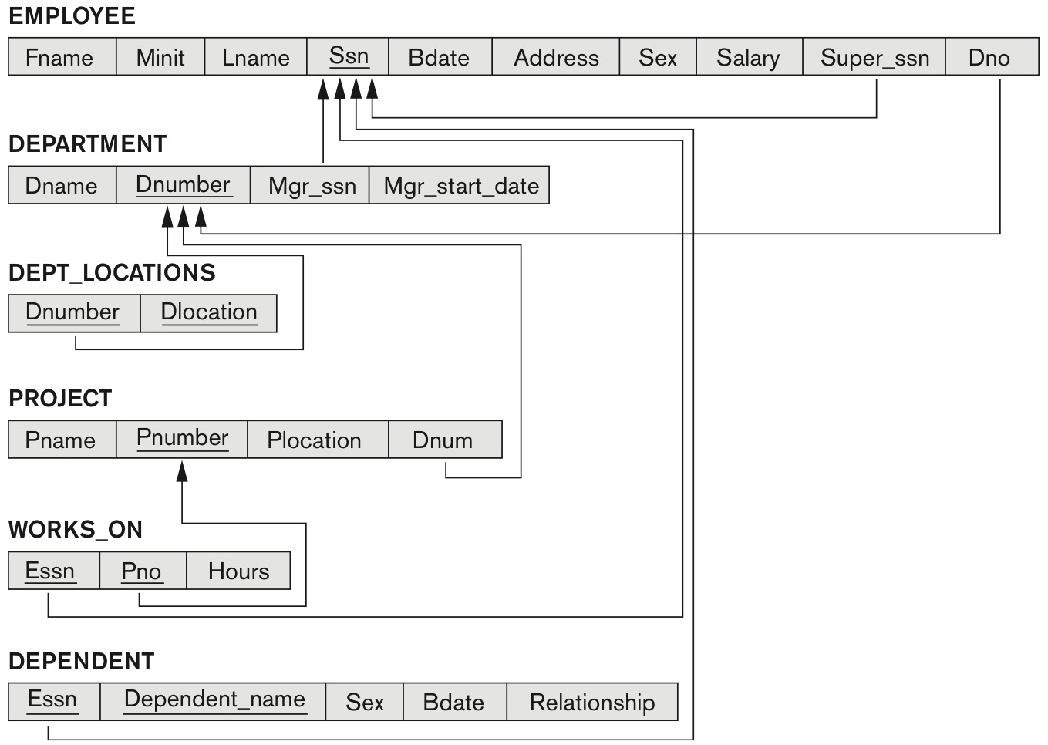
Company database – relational model

Slide 3
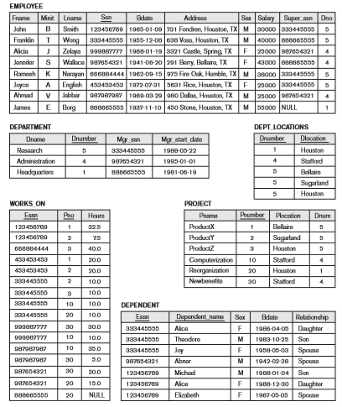
State of Company relational database schema

Slide 4
INSERT, DELETE and UPDATE Statements in SQL
Three commands used to modify the database:
INSERT, DELETE, and UPDATE
INSERT typically inserts a tuple (row) in a relation (table)
UPDATE may update a number of tuples (rows) in a relation (table) that satisfy the condition
DELETE may also update a number of tuples (rows) in a relation (table) that satisfy the condition

Slide 5
INSERT
In its simplest form, it is used to add one or more tuples to a relation
Attribute values should be listed in the same order as the attributes were specified in the CREATE TABLE command
Constraints on data types are observed automatically
Any integrity constraints as a part of the DDL specification are enforced

Slide 6

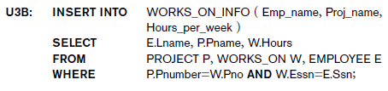
The INSERT Command
Specify the relation name and a list of values for the tuple. All values including nulls are supplied.
The variation below inserts multiple tuples where a new table is loaded values from the result of a query.

Slide 7
BULK LOADING OF TABLES
Another variation of INSERT is used for bulk-loading of several tuples into tables
A new table TNEW can be created with the same attributes as T and using LIKE and DATA in the syntax, it can be loaded with entire data.
EXAMPLE:
CREATE TABLE D5EMPS LIKE EMPLOYEE
(SELECT E.*
FROM EMPLOYEE AS E
WHERE E.Dno=5)
WITH DATA;

Slide 8
UPDATE
Used to modify attribute values of one or more selected tuples
A WHERE-clause selects the tuples to be modified
An additional SET-clause specifies the attributes to be modified and their new values
Each command modifies tuples in the same relation
Referential integrity specified as part of DDL specification is enforced

Slide 9
UPDATE
Example: Change the location and controlling department number of project number 10 to 'Bellaire' and 5, respectively
U5: UPDATE PROJECT SET PLOCATION = 'Bellaire', DNUM = 5 WHERE PNUMBER=10

Slide 10
UPDATE
Example: Give all employees in the 'Research' department a 10% raise in salary.
U6: UPDATE EMPLOYEE SET SALARY = SALARY *1.1 WHERE DNO IN (SELECT DNUMBER FROM DEPARTMENT WHERE DNAME='Research')
In this request, the modified SALARY value depends on the original SALARY value in each tuple
The reference to the SALARY attribute on the right of = refers to the old SALARY value before modification
The reference to the SALARY attribute on the left of = refers to the new SALARY value after modification

Slide 11
DELETE
Removes tuples from a relation
Includes a WHERE-clause to select the tuples to be deleted
Referential integrity should be enforced
Tuples are deleted from only one table at a time (unless CASCADE is specified on a referential integrity constraint)
A missing WHERE-clause specifies that all tuples in the relation are to be deleted; the table then becomes an empty table
The number of tuples deleted depends on the number of tuples in the relation that satisfy the WHERE-clause

Slide 12
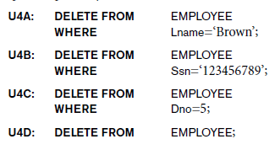
The DELETE Command
Removes tuples from a relation
Includes a WHERE clause to select the tuples to be deleted. The number of tuples deleted will vary.

Slide 13
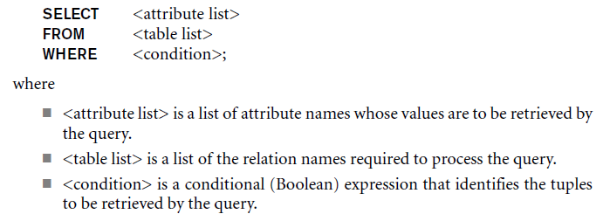
The SELECT-FROM-WHERE Structure of Basic SQL Queries
Basic form of the SELECT statement:

Slide 14
The SELECT-FROM-WHERE Structure of Basic SQL Queries
Logical comparison operators
=, <, <=, >, >=, and <>
Projection attributes
Attributes whose values are to be retrieved
Selection condition
Boolean condition that must be true for any retrieved tuple. Selection conditions include join conditions when multiple relations are involved.

Slide 15
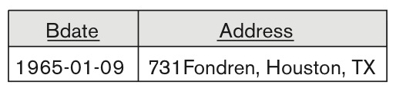
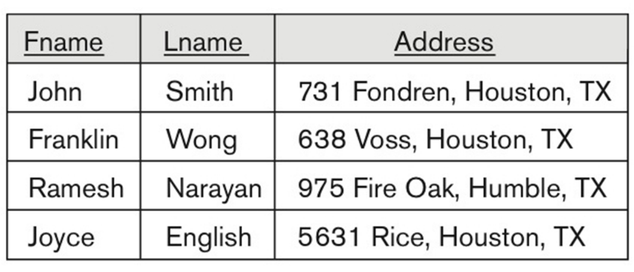
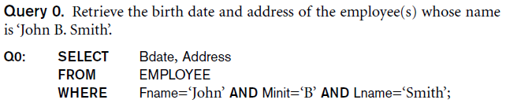
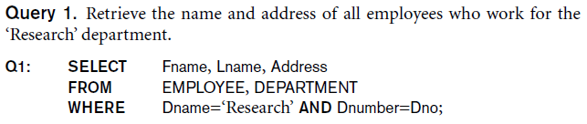
Basic Retrieval Queries

Slide 16
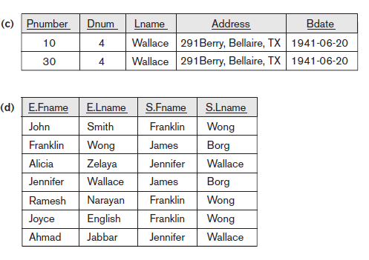
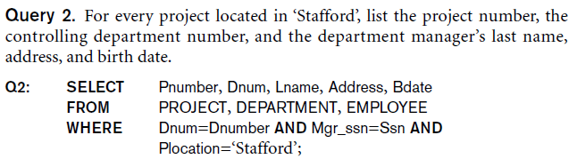
Basic Retrieval Queries (Contd.)

Slide 17

Ambiguous Attribute Names
Same name can be used for two (or more) attributes in different relations
As long as the attributes are in different relations
Must qualify the attribute name with the relation name to prevent ambiguity

Slide 18
Aliasing, and Renaming
Aliases or tuple variables
Declare alternative relation names E and S to refer to the EMPLOYEE relation twice in a query:
Query 8. For each employee, retrieve the employee’s first and last name and the first and last name of his or her immediate supervisor.
SELECT E.Fname, E.Lname, S.Fname, S.Lname
FROM EMPLOYEE AS E, EMPLOYEE AS S
WHERE E.Super_ssn=S.Ssn;
Recommended practice to abbreviate names and to prefix same or similar attribute from multiple tables.

Slide 19
Aliasing,Renaming and Tuple Variables (contd.)
The attribute names can also be renamed
EMPLOYEE AS E(Fn, Mi, Ln, Ssn, Bd, Addr, Sex, Sal, Sssn, Dno)
Note that the relation EMPLOYEE now has a variable name E which corresponds to a tuple variable
The “AS” may be dropped in most SQL implementations

Slide 20
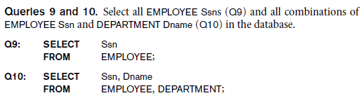
Unspecified WHERE Clause and Use of the Asterisk
Missing WHERE clause
Indicates no condition on tuple selection
Effect is a CROSS PRODUCT
Result is all possible tuple combinations result

Slide 21
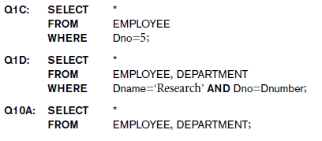
Unspecified WHERE Clause and Use of the Asterisk
Specify an asterisk (*)
Retrieve all the attribute values of the selected tuples
The * can be prefixed by the relation name; e.g., EMPLOYEE *

Slide 22
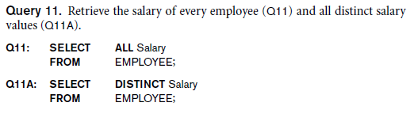
Tables as Sets in SQL
SQL does not automatically eliminate duplicate tuples in query results
For aggregate operations duplicates must be accounted for
Use the keyword DISTINCT in the SELECT clause
Only distinct tuples should remain in the result

